Slide 1
Gated Recurrent Unit
(GRU)

Slide 2
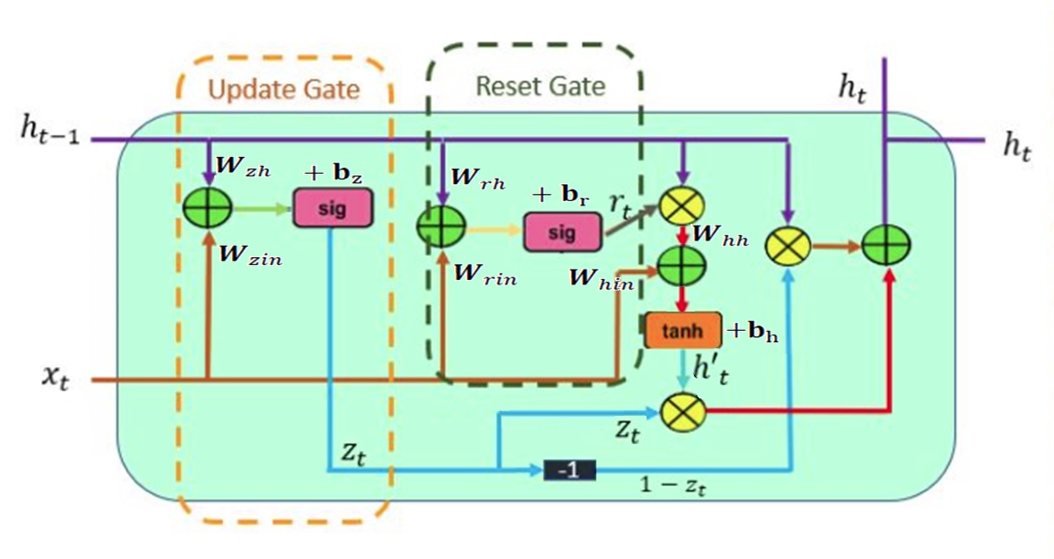

Slide 3
